Slide 1











The Association Between Dementia and Atrial Fibrillation Stratified by Family History of Cardiovascular Disease
Mya Watson, Manasi Prashant, BS; Jing Wang, MHS; Michelle Johansen, MD, PhD

Slide 2

Abstract
  Dementia...
    is a condition in which "one has difficulty with several types of cognitive abilities, most often with memory but also with language, attention, orientation, judgment, and planning”¹.
    impacts more than 55 million individuals, with millions more new cases every year^{2.}
  As a result of the prevalence of dementia...
    The causes of dementia have been extensively studied
      One area of interest is the strong correlation between cardiovascular disease (CVD) and dementia³.
        This research study aims to understand how the association between a specific type of CVD, atrial fibrillation, and dementia differs by one’s family history of CVD.

Slide 3

: The Parent Study
  The parent study for this research project is called NOMINATE, which stands for determiNants Of AlzheiMer’s DIsease iN Atrial fibrillation aparT from strokE
    It seeks to answer the question: Is Atrial Fibrillation (AF) associated with Alzheimer's Dementia (AD) apart from stroke?
    In this study, high-risk CVD patients with and without AF are screened to determine their eligibility in the study.
    Blood samples of consented patients are collected and later analyzed for potential AD biomarkers.
    These blood samples will allow us to determine whether high-risk CVD patients with AF have elevated levels of AD-associated plasma biomarkers in comparison to high-risk CVD patients without AF.
Notes:
Stroke causes dementia, atrial fib causes stroke, can afib cause dementia directly?

Slide 4
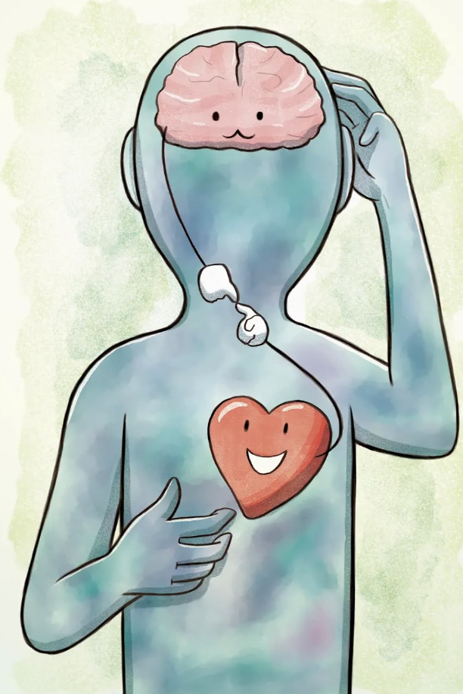
My Research Project
  How does the parent study, NOMINATE, and my research project overlap?
    My research project will be focused on a subset of the high-risk CVD patients already screened through NOMINATE (n=200).
      Diagnostic data will be collected for each patient within this subset using their Electronic Health Records (EHR), including..
        Dementia History
        Atrial Fibrillation History
        Relevant Cardiovascular History
        Family History of CVD

Slide 5

What is the objective of my research project?
  The objective of this study is to utilize the data from the prospective ongoing NOMINATE study to answer the following question:
  How does the association between atrial fibrillation and dementia differ based on family history of cardiovascular disease?

Slide 6
Methods
  Using statistical techniques, this study used a weighted, randomly generated sample of cardiology patients screened for the NOMINATE study (n=806)
  Data was collected from the EHR of each patient in the generated sample (n=200) regarding..
    Exposure (Independent Variable):
      Atrial Fibrillation (defined as 1- diagnosis of Atrial Fibrillation or Atrial Arrhythmia present in the Electronic Health Records at the time of screening, 2- two or more AF events in the last 6 months, including being prescribed meds for AF, evidence on ECG, and 3- cannot have an ablation within one year of the time of screening)
    Outcome (Dependent Variable):
      Dementia (defined as a diagnosis of Mild Cognitive Impairment, Vascular Dementia, Alzheimer's Dementia, Parkinson’s Dementia, or Unspecified Dementia by a physician or reported by the patient and documented in the chart at the time of screening)
Notes:
Exposure== anything that may be associated with the outcome of interest
Outcome == Dependent Variable, the thing being affected by exposure
Interaction Term== a variable that could change the relationship between the independent variable (exposure/exposure/afib) and the dependent variable (dementia)

Slide 7
Methods
  Interaction Term:
      Family history of CVD (defined as a CVD diagnosis associated with their parent(s), sibling(s), or children as noted by a JHMI specialist)
  Covariates: Other demographic and diagnostic information collected from the patient, including age, sex, history of heart failure (HF), history of diabetes, ect. (Shown in Table 1)
  Analysis:
    Appropriate logistical regression models were used to determine the association between Atrial Fibrillation and Dementia with interaction terms to determine if there was a difference by family history of CVD.

Slide 8
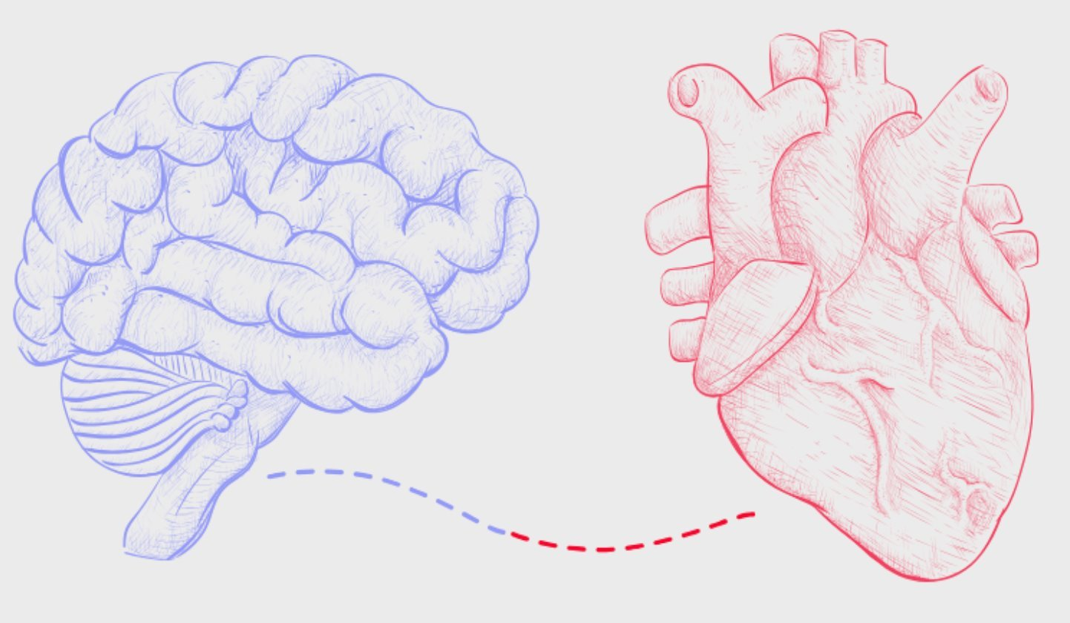
RESULTS

Slide 9
Results: Table 1
Table 1: Demographic of Patients With and Without a Family History of Cardiovascular Disease (CVD).
 | Total | Patients without family history of CVD | Patients with family history of CVD | p-value
 | N= 200 | N= 70 | N= 130
Age | 71.0 (9.6) | 72.2 (9.5) | 70.4 (9.6) | 0.22
Sex (Female vs. Male) | 100 (50.0%) | 34 (48.6%) | 66 (50.8%) | 0.77
Race (Caucasian vs. Others) | 138 (69.0%) | 41 (58.6%) | 97 (74.6%) | 0.019
History of Atrial Fibrillation | 64 (32.0%) | 24 (34.3%) | 40 (30.8%) | 0.61
History of Hypertension | 128 (64.0%) | 46 (65.7%) | 82 (63.1%) | 0.71
History of Heart Failure | 38 (19.0%) | 10 (14.3%) | 28 (21.5%) | 0.21
History of diabetes | 48 (24.0%) | 17 (24.3%) | 31 (23.8%) | 0.94
Continuous Variable were displayed with Mean (SD); Categorical variable were displayed with N (%)

Slide 10
Results: Table 2 and 3
Table 2: Association between Atrial Fibrillation and Dementia
 | Univariate | Model 1
 | OR (95% CI) | OR (95% CI)
Atrial Fibrillation | 1.13(0.60, 2.13) | 1.11 (0.55, 2.24)
Model 1 adjusted for age, sex (Female vs. Male), race (Caucasian vs. others) Abbreviation: OR: Odds Ratio, CI: Confident Interval
Table 3: The Association between Atrial Fibrillation and Dementia, Stratified by Family History of CVD
 | Univariate |  | Model 1
 | p-interaction | OR (95% CI) | p-interaction | OR (95% CI)
Family History of CVD Yes No | 0.008 | 2.31 (1.00, 5.34) 0.38 (0.14, 1.08) | 0.013 | 2.10 (0.86, 5.14) 0.32 (0.09, 1.11)
Model 1 adjusted for age, sex (Female vs. Male), race (Caucasian vs. others) Abbreviation: OR: Odds Ratio, CI: Confident Interval
Among patients who have a family history of CVD, those with AF had increased odds of dementia compared to those without AF (OR 2.31 95%CI 1.00, 5.34)
We can see that patients with AF AND family history of CVD do have slightly increased odds of having dementia in comparison to patients with AF without family history of CVD, but this association is NOT statistically significant except for the univariate model in Table 3.
Notes:
We can see that patients with Atrial Fibrillation do have slightly increased odds of having dementia if they have a family history of CVD, but this association is NOT statistically significant except for the univariate model in Table 3.

Slide 11
What are the implications of these results?
These results could lead to further research projects focusing on preventative measures for AF patients who have a family history of CVD.
Clinical implications of this project would include providing information to AF patients who have a family history of CVD and their physicians to consider the potential for being diagnosed with dementia.

Slide 12
References
  Arvanitakis Z, Bennett DA. What Is Dementia? JAMA. 2019;322(17):1728. doi:10.1001/jama.2019.11653
  World Health Organization. (2023, March 15). Dementia. World Health Organization. https://www.who.int/news-room/fact-sheets/detail/dementia
  Newman, A.B., Fitzpatrick, A.L., Lopez, O., Jackson, S., Lyketsos, C., Jagust, W., Ives, D., DeKosky, S.T. and Kuller, L.H. (2005), Dementia and Alzheimer's Disease Incidence in Relationship to Cardiovascular Disease in the Cardiovascular Health Study Cohort. Journal of the American Geriatrics Society, 53: 1101-1107. https://doi.org/10.1111/j.1532-5415.2005.53360.x

Slide 13



Special Thanks!
Special thanks to Dr. Johansen, the PI of the NOMINATE study, and the amazing NOMINATE team for their support on this project!
Michelle Johansen MD PhD, Principal Investigator
Associate Professor of Neurology at JHMI
Jing Wang, MHS
Lead Research Coordinator
Manasi Prashant, BS,
Research Assistant

